Slide 1
EGB1201 – JAVA PROGRAMMING
Department Of Electronics and Communication Engineering
Academic Year: 2024 – 2025 (Odd Semester)
Register Number :8115U23EC001
Name :AARTHI.S
Year :II
Semester :III

Slide 2
Title of the Project
SCIENTIFIC CALCULATOR

Slide 3
Abstract
This Java-based scientific calculator performs both basic operations like addition, subtraction, multiplication, and division, and advanced scientific functions. The basic mode ensures accurate, user-friendly computations with robust error handling, including safeguards against division by zero. Designed for cross-platform compatibility, it offers a versatile and maintainable solution for diverse mathematical needs.

Slide 4
Abstract with CO/PO Mapping
Abstract | CO | POs | PSO
The Java-based Scientific Calculator is designed to perform both basic arithmetic operations (addition, subtraction, multiplication, division) and advanced mathematical functions, including trigonometry and logarithms. It incorporates Object-Oriented Programming (OOP) principles, robust error handling, and user-friendly interfaces. The application is cross-platform compatible, ensuring accessibility and reliability for diverse computational needs. | CO 1 CO 2 CO 3 | PO 1 PO 2 PO 3 PO 5 PO 8 PO 9 | PSO 2

Slide 5
Introduction
This scientific calculator, developed in Java, performs both basic and advanced mathematical operations. It features Basic Mode for simple arithmetic and Scientific Mode for complex functions like trigonometry and logarithms. With a user-friendly interface, cross-platform compatibility, and robust error handling, the calculator is designed to meet diverse mathematical needs efficiently and reliably.

Slide 6
Java Programming - Concepts Used
Object-Oriented Programming (OOP): Uses inheritance, encapsulation, and polymorphism for modular and reusable code.
Exception Handling: Manages errors like division by zero for smooth operation.
GUI Design: Utilizes Swing or JavaFX for an interactive user interface.
Math Library: Leverages Java’s Math class for advanced functions.
Control Structures: Employs loops and conditionals for program logic.
Event Handling: Handles user input and button clicks with event listeners.
Modularity: Divides the program into manageable, scalable components.

Slide 7
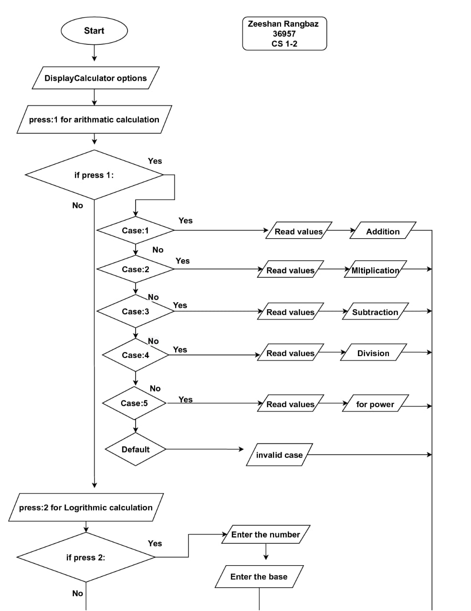
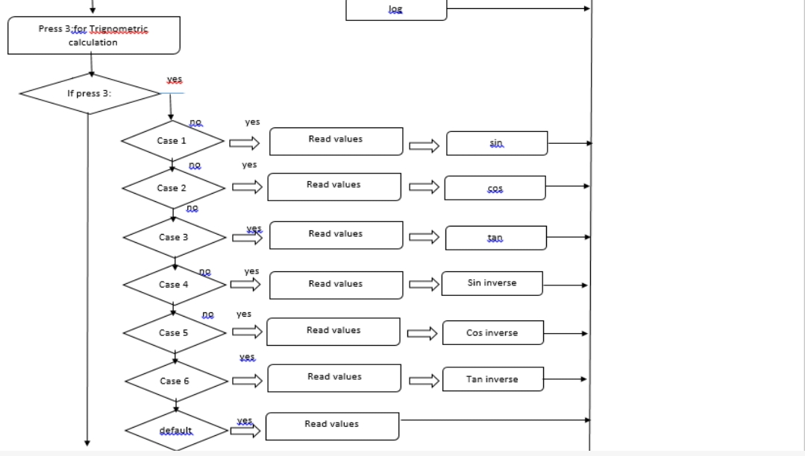
Proposed Architecture

Slide 8
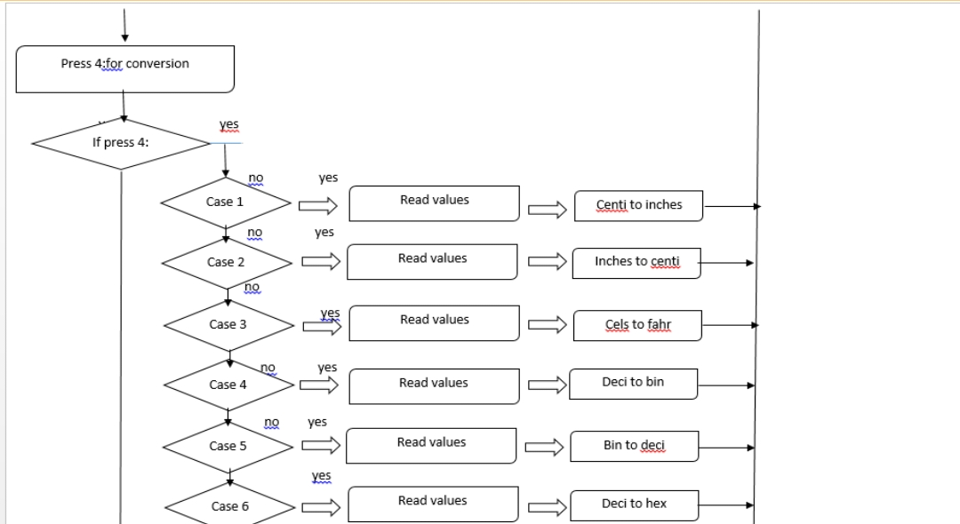
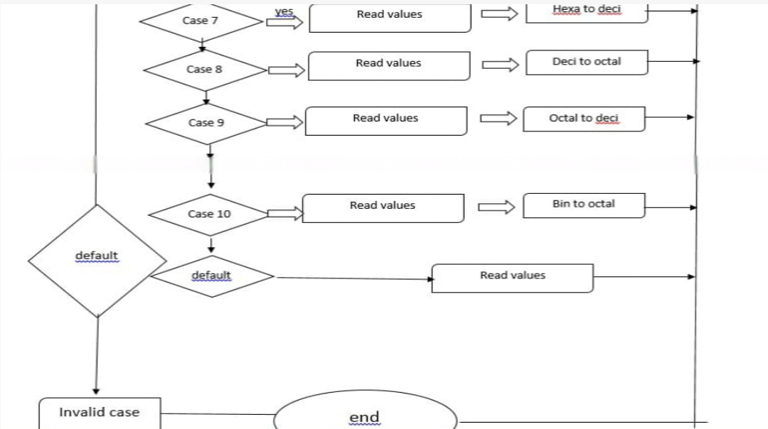
Proposed Architecture

Slide 9
Proposed Architecture - Description
The flowchart is divided into sections for various types of calculations and conversions based on user input:
1. Arithmetic Calculation (Press 1):After selecting this option, the user is prompted to choose between different arithmetic operations such as addition, subtraction, multiplication, and division, based on further input (e.g., Case 1 for addition, Case 2 for multiplication)
.2. Logarithmic Calculation (Press 2):This section handles logarithmic calculations, with options for various log operations such as sine, cosine, and tangent, depending on the case selected by the user.
3. Trigonometric Calculation (Press 3):Provides options for trigonometric functions like sine, cosine, and their inverses, along with other trigonometric calculations

Slide 10
Proposed Architecture - Description (Cont..)
4. Unit Conversion (Press 4):This section includes conversions between units such as converting inches to centimeters, converting decimal to binary, or converting hexadecimal to decimal. Various cases are provided for different types of conversions (e.g., Case 3 for decimal to binary, Case 9 for octal to decimal).
5. Invalid Case:If the user enters an invalid option, the flowchart directs them to an "invalid case" before ending the process.
Each step includes decisions (Yes/No) that guide the flow to the appropriate action or calculation. The diagram concludes with an "end" point after all cases are processed.

Slide 11
List of Modules
1.Input module
2.Basic Operation Module
3.Scientific Operation Module
4.User Interfacemodule
5.Error Handling Module

Slide 12
Module Description
1. Input Module
Handles user input, including numeric values, operations, and mode selections (Basic or Scientific). It validates and processes the data for calculations.
2. Basic Operation Module
Performs fundamental arithmetic calculations such as addition, subtraction, multiplication, and division. It handles simple mathematical operations in Basic Mode.
3. Scientific Operation Module
Handles advanced mathematical operations like trigonometric functions (sine, cosine), logarithms, exponentials, and square roots, available in Scientific Mode.

Slide 13
Module Description (Cont..)
4. User Interface Module
Provides the graphical interface for user interaction, including buttons, input fields, and displays, designed using Swing or JavaFX for a seamless experience.
5. Error Handling Module
Manages input errors (e.g., division by zero, invalid expressions) and displays appropriate error messages, ensuring smooth operation and preventing crashes.

Slide 14
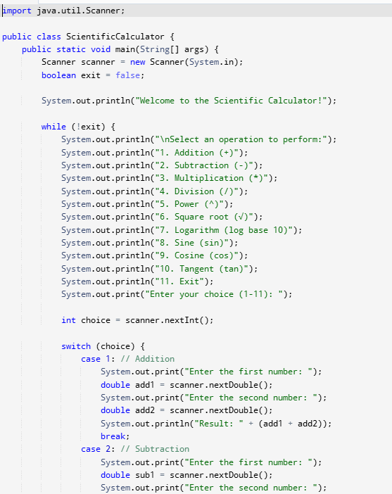
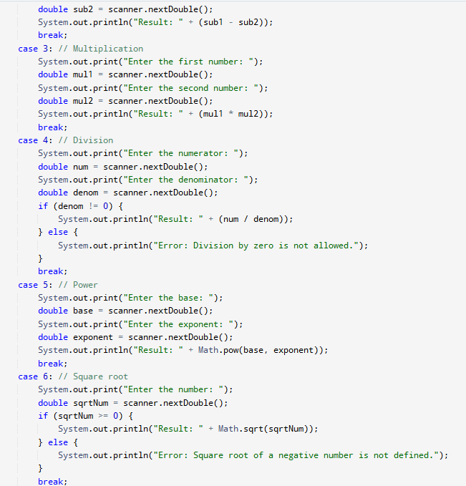
PROGRAM

Slide 15
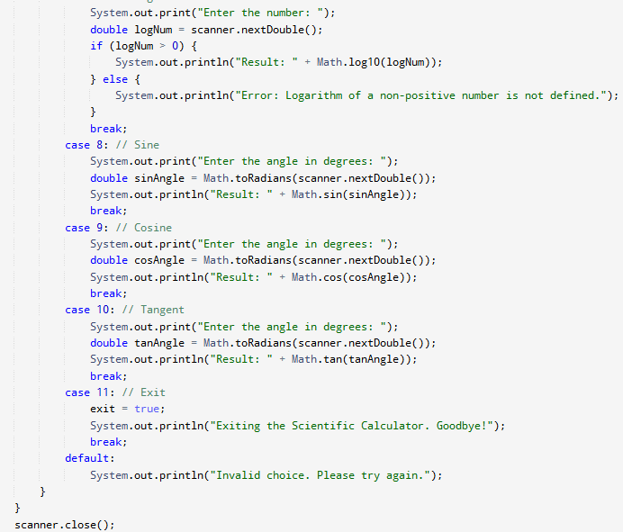
PROGRAM

Slide 16
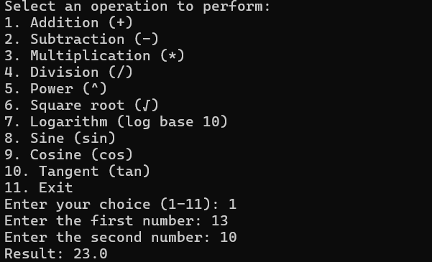
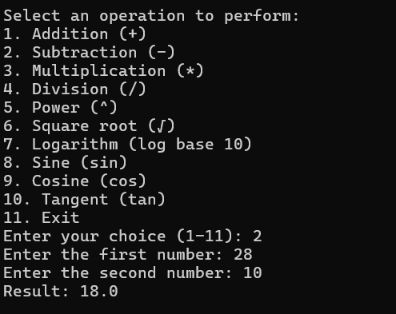
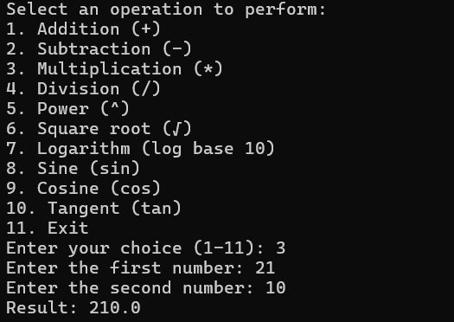
OUTPUT

Slide 17
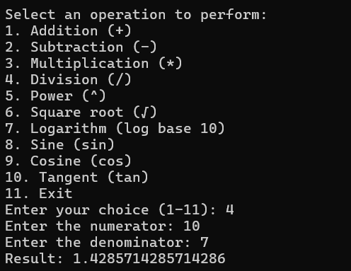
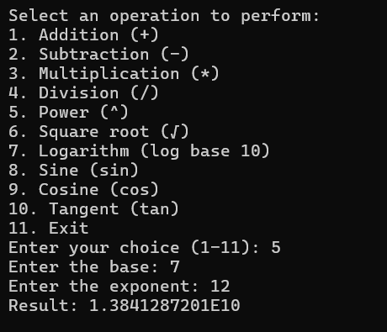
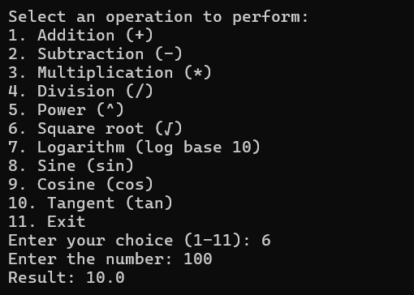
OUTPUT

Slide 18
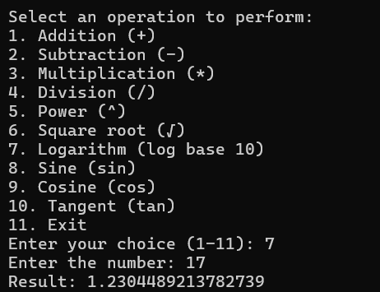
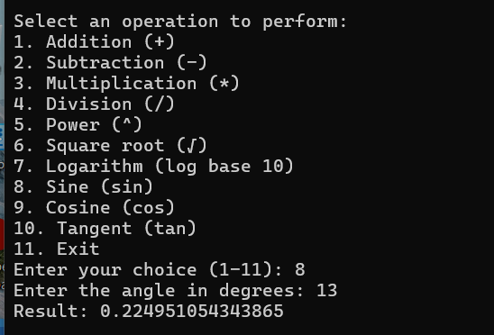
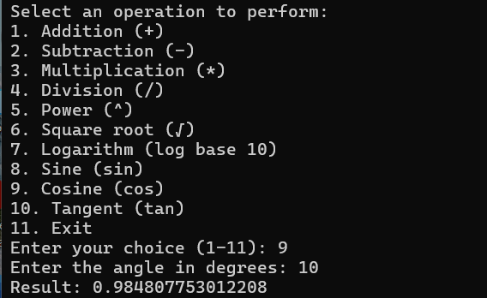
OUTPUT

Slide 19
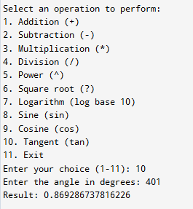
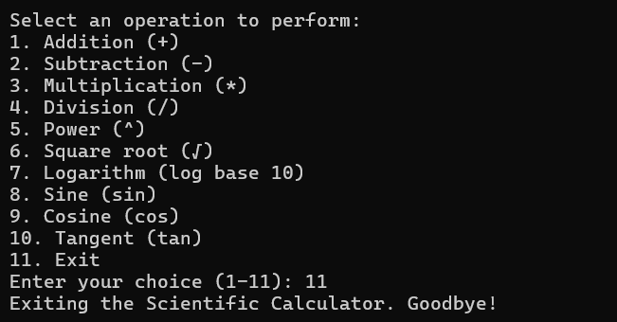
OUTPUT

Slide 20
Results and Discussion
Results
The Java-based scientific calculator successfully handles basic arithmetic operations and advanced scientific functions like trigonometry and logarithms. The user interface is intuitive, and error handling ensures that invalid inputs are managed properly. The application performs well across multiple platforms, offering accurate results in both Basic Mode and Scientific Mode.
Discussion
The calculator provides reliable functionality and a smooth user experience. It is efficient for basic and complex operations, though future enhancements like memory functions or a history feature could improve usability. The use of Java ensures cross-platform compatibility, and error handling prevents crashes, making it a robust tool for everyday and scientific calculations.

Slide 21
Conclusion
The Java-based scientific calculator successfully meets the goal of providing both basic and advanced mathematical functionalities in a user-friendly interface. With accurate calculations, intuitive controls, and effective error handling, it offers a reliable tool for performing everyday and scientific calculations across different platforms. The use of Java ensures cross-platform compatibility, making it accessible to a wide range of users. Looking forward, potential improvements include adding memory features, optimizing performance for complex operations, and improving the overall user experience.

